Slide 1
Final Year Project Presentation
Prediction And Analysis of Trends In Cryptocurrency Market
Carried out by:
1MV14CS093 : Saurabh Prakash
1MV14CS109 : Sudarshan Kumar
Under the guidance of:
Dr. Suma Swamy
Professor
Dept. of Computer Science

Slide 2
Outline
Introduction
Literature Review
System Requirements
Implementation
System Design And Analysis
Conclusion
References

Slide 3
Introduction
What actually is out project?
Our project titled “Prediction And Analysis of Trends in Cryptocurrency Market” applies Exploratory Data Analysis on a set of data of historical prices of Cryptocurrency to find answers to some fascinating questions.
This project aims at applying Data Science and Machine Learning in order to analyse and predict the nature of Cryptocurrency Market. This analysis and prediction should be such that it can be easily used by the users in order to exploit the Cryptocurrency Market.

Slide 4
Introduction
Objective of the Project
This project aims at applying Data Science and Machine Learning in order to analyze and predict the nature of Cryptocurrency Market.
This analysis and prediction should be such that it can be easily used by the users in order to exploit the Cryptocurrency Market and thus making rational decisions in choosing the right Cryptocurrency to invest in.

Slide 5
Introduction
Objective of the Project
Exploratory Data Analysis, commonly known as EDA, is used in this project which makes use of visualization techniques to clean and understand the data. EDA makes the data neat to be able to be used for Machine Learning.
By analyzing these graphs, the main aim is to find the trends which the changes in the prices of different Cryptocurrencies follow. Also, we aim to find relationships between the price variations of different Cryptocurrencies if they exist.

Slide 6
Introduction
Objective of the Project
Lastly, this project aims at predicting the prices of different Cryptocurrencies based on the changes in their prices in the past.
Once these features are implemented in entirety, the project aims to be good and simple enough to be used by a naïve user by reading just a simple set of instructions.

Slide 7
Introduction
Scope of the Project
People usually have hard time deciding which Cryptocurrency to invest in. Since their prices vary a lot and most of the users find this variation unpredictable, they end up investing either in the wrong cryptocurrency, investing a wrong amount or investing at the wrong time leading to a loss to them.
Analysis means detailed examination of the elements or structure of something. If anything is analyzed properly, it can be understood clearly, and thus right decisions can be taken involving those things.

Slide 8
Introduction
Scope of the Project
People usually have hard time deciding which Cryptocurrency to invest in. Since their prices vary a lot and most of the users find this variation unpredictable, they end up investing either in the wrong cryptocurrency, investing a wrong amount or investing at the wrong time leading to a loss to them.
Analysis means detailed examination of the elements or structure of something. If anything is analyzed properly, it can be understood clearly, and thus right decisions can be taken involving those things.

Slide 9
Literature Review
What is Data?
This project provides an insight into how the prices of different Cryptocurrencies varied with time as well as providing predictions for fluctuations in their prices in the future, it will help users in understanding the Cryptocurrency market better.
All the functions that are used in this project are shipped in packages on The Comprehensive R Archive Network, commonly known as CRAN.
This will help a user sitting in any part of the world to import these packages to perform various analysis and predictions on the Cryptocurrency Market in a seamless handy way.

Slide 10
Literature Review
What is Data?
Data can also be seen as a set of values of qualitative or quantitative variables.
A qualitative variable, also called a categorical variable, are variables that are not numerical. It describes data that fits into categories.
Quantitative variables have a value and they can be added, subtracted, divided or multiplied.

Slide 11
Literature Review
Data Analysis
Data Analysis is a process of inspecting, cleansing, transforming, and modelling data with the goal of discovering useful information, suggesting conclusions, and supporting decision-making.
Data analysis is a process for obtaining raw data and converting it into information useful for decision-making by users.
Data is collected and analysed to answer questions, test hypotheses or disprove theories.

Slide 12
Literature Review
How is Data Analysis Performed?
Following Steps are involved in Data Analysis :
Defining Objectives
Posing Questions
Data Collection
Data Wrangling
Data Analysis
Drawing Conclusions and Making Predictions

Slide 13
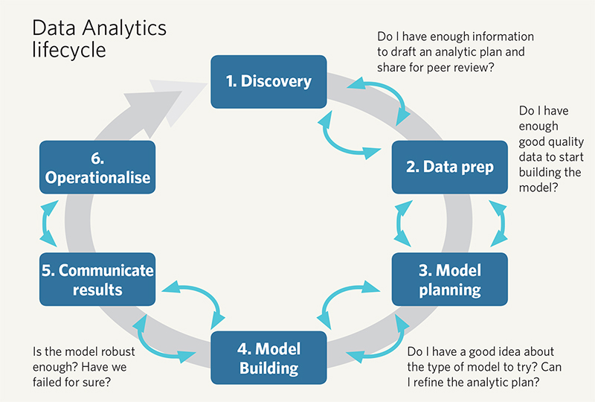
Literature Review

Slide 14
Literature Review
Exploratory Data Analysis
Exploratory Data Analysis (EDA) is an approach/philosophy for data analysis that employs a variety of techniques (mostly graphical) to maximize insight into a data set, uncover underlying structure, extract important variables, detect outliers and anomalies, test underlying assumptions, develop parsimonious models; and determine optimal factor settings.

Slide 15
Literature Review
Exploratory Data Analysis
The primary goal of EDA is to maximize the analyst's insight into a data set and into the underlying structure of a data set, while providing all of the specific items that an analyst would want to extract from a data set, such a good - fitting, parsimonious model, a list of outliers, a sense of robustness of conclusions, estimates for parameters, uncertainties for those estimates, a ranked list of important factors, conclusions as to whether individual factors are statistically significant and a lot more.

Slide 16
Literature Review
The Role of Graphics
Statistics and data analysis procedures can broadly be split into two parts:
quantitative
graphical
Quantitative techniques are the set of statistical procedures that yield numeric or tabular output. Examples of quantitative techniques include:
hypothesis testing
analysis of variance
point estimates and confidence intervals
least squares regression

Slide 17
Literature Review
The Role of Graphics
On the other hand, there is a large collection of statistical tools that are generally referred to as graphical techniques. These include:
scatter plots
histograms
probability plots
residual plots
box plots
block plot

Slide 18
Literature Review
R Programming Language
R is a language and environment for statistical computing and graphics. It is a GNU project which is similar to the S language and environment which was developed at Bell Laboratories (formerly AT&T, now Lucent Technologies) by John Chambers and colleagues.
R provides a wide variety of statistical (linear and nonlinear modelling, classical statistical tests, time-series analysis, classification, clustering,…) and graphical techniques, and is highly extensible.

Slide 19
Literature Review
R Programming Language
One of R’s strengths is the ease with which well-designed publication-quality plots can be produced, including mathematical symbols and formulae where needed. Great care has been taken over the defaults for the minor design choices in graphics, but the user retains full control.

Slide 20
Literature Review
ggplot2
gplot2 is a plotting system for R, based on the grammar of graphics, which tries to take the good parts of base and lattice graphics and none of the bad parts.
It takes care of many of the fiddly details that make plotting a hassle (like drawing legends) as well as providing a powerful model of graphics that makes it easy to produce complex multi-layered graphics.
ggplot2 is an implementation of Leland Wilkinson's Grammar of Graphics—a general scheme for data visualization which breaks up graphs into semantic components such as scales and layers.

Slide 21
System Requirements
Hardware Requirements
An Intel-compatible platform running Windows 2000, XP/2003/Vista/7/8/2012
Server/8.1/10.
At least 32 MB of RAM, a mouse, and enough disk space for recovered files, image
files, etc.
The administrative privileges are required to install and run R-Studio utilities under
Windows 2000/XP/2003/Vista/7/8/2012 Server/8.1/10.

Slide 22
System Requirements
Software Requirements
MS Windows/Mac OS or any Linux based OS.
R Version 3.4.2 or higher.
R Studio Version 1.1.383 or higher.
Sublime Text Editor.

Slide 23
Implementation
Our project tries to find answers to all these questions by applying Exploratory Data Analysis on a set of Cryptocurrency Data.
We have a data containing data of 1320 types of Cryptocurrencies. This data contains about 65000 observations of 10 variables. These 10 variables are Date, Open, High, Low, Close, Volume, Market.Cap, coin and Delta.
Added to this, we have added one extra variable, delta, to this data. Delta, for a particular day, is the difference of Open and Close divided by Open.

Slide 24
Implementation
Date | : | Date of observation
Open | : | Opening price on the given day
High | : | Highest price on the given day
Low | : | Lowest price on the given day
Close | : | Closing price on the given day
coin | : | Name of the cryptocurrency
Volume | : | Volume of transactions on the given day
Market Cap | : | Market capitalization in USD

Slide 25
Implementation
The first step was to find out the most dominant or important Cryptocurrencies in the market. So a parameter had to be chosen which could be used as a measure of this dominance. We decided to use the parameter Market.Cap.
For Cryptocurrencies, according to coinmarketcap.com, Market Capitalization is one way to rank the relative size of a cryptocurrency. It's calculated by multiplying the Price by the Circulating Supply.
Market Cap = Price X Circulating Supply

Slide 26
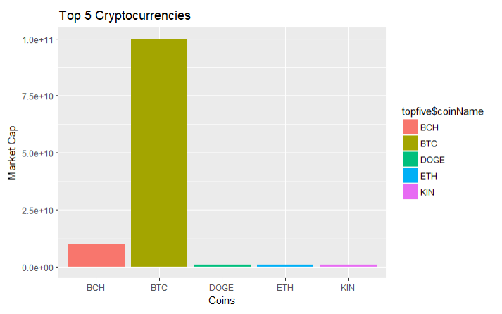
Implementation
To find out the most dominant Cryptocurrencies in the market, we plotted a bar graph
of the Top 5 Cryptocurrencies in the market.

Slide 27
Implementation
To find out the most dominant Cryptocurrencies in the market, we plotted a bar graph
of the Top 5 Cryptocurrencies in the market.
Coin Name | Market Cap
BTC( Bitcoin) | 99941600000
BCH(Bitcoin Cash) | 9866110000
ETH (Ethereum ) | 999757000
KIN | 999563000
DOGE | 998995000

Slide 28
Implementation
It is evident from the above Bar Graph, Bitcoin (BTC) alone dominates the Cryptocurrency market by a very large margin. It has a Market Capitalization of 99941600000 USD according to our data. Bitcoin Cash follows Bitcoin (BTC) in the Market Capitalization. It has a Market Capitalization of 9866110000 USD. Ethereum (Eth), KIN and DOGE follows BCH. All of these have almost same Market Capitalization. The market Capitalization of Ethereum (ETH), KIN and DOGE are 999757000 USD, 999563000 USD and 998995000 USD respectively.

Slide 29
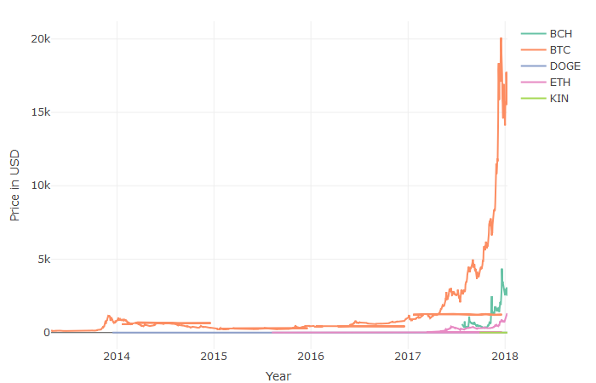
Implementation
So what we did after this was plotting the Time Series of all these Cryptocurrencies. A Time Series
of a Cryptocurrency shows the variation in the price, in USD, of that Cryptocurrency with time.

Slide 30
System Design And Analysis
Step 1: First step is to analyze the input format of the data.
Step 2:If the format correspond to the correct type then move further otherwise change to correct format.
Step 3:Have a look at the deviation of the values in the data or missing value.
Step 4: Based on the percentage of deviation. Decide what method to use for replacing it with the correct value

Slide 31
System Design And Analysis
Step 5:
If the total percent is vary less than the whole population then replace it with 0.
If the total percent is less but the value is uniform than mean value can be placed in place of missing or corrupt data.
If the total percent is very less but outliers is high the median can be used.
d) If it does not match with the above type then different approach can be used based on the amount of invariability shown by the data.

Slide 32
System Design And Analysis
Step 6: Next step is to find relationship between different attribute.
Step 7: Generate hypothesis which data should follow.
Step 8: Based on the hypothesis Explore the data
a) Exploration can be graph based. (ggplot2 will be used for grap
b) Exploration can be Probabilistic.
Step 9: After the relationship is found, device a model which the dataset will follow.

Slide 33
System Design And Analysis
Step 10: Divide the data into test and train set. The model will be formed with the train data and tested on train data.The outcome can be of three types:
a) Model is correct because hypothesis is good.
b) Hypothesis is wrong leading to wrong model, change the hypothesis
c) Data does not contain any relationship to model.
Step 11: If the model is correct then we can predict the outcome of the next behaviour of data, using which a user can invest properly in the Cryptocurrencies.

Slide 34
Conclusion
Exploratory Data Analysis is a relatively new field. The amount of data that is generated daily is huge. Combining it with Machine Learning forms an interesting combination. These are very vast fields and as time progresses, the implementation of these techniques in the project can be improved in order to produce more reliable outputs.
Cryptocurrency Market is an emerging market that attracts a lot of attention. This project gave us a lot of insights into how the Cryptocurrency Market works.
Cryptocurrency Market is somewhat unpredictable. Nobody knows what exactly will happen in the next moment. Yet, we just gave a try at exploring and predicting the trends in these market.

Slide 35
References
[1] Introduction to R Software by NPTEL conducted by IIT Kharagpur.
[2] Introduction to Data Analysis by NPTEL conducted by IIT Madras.
[3] Exploratory Data Analysis on Udacity.
[4] R in Action: Data Analysis and Graphics with R, 2nd Edition, Robert L Kabacoff.
[5] THE VISUAL DISPLAY OF QUANTITATIVE INFORMATION, 2nd Edition, Edward R Tufte.

Slide 36
References
[6] For Obtaining Datasets - https://www.kaggle.com/rajanand/education-in-india
[7] For technical queries - https://stackoverflow.com/
[8] For Tutorials - https://www.youtube.com/
[9]https://stats.stackexchange.com/questions/220865/how-to-select-a- range-of-dates-in-r

Slide 37
References
[10]https://www.youtube.com/watch?v=rsG-GgR0aEY
[11]https://cran.r-project.org/web/packages/coinmarketcapr/
coinmarketcapr.pdf
[12]https://stackoverflow.com/questions/11748384/formatting-dates-on-x-axis-in-ggplot2
[13]https://cointelegraph.com/

Slide 38
References
[14]https://en.wikipedia.org/wiki/Fibonacci_retracement
[15]https://www.investopedia.com/terms/m/marketcapitalization.asp
[16]https://dplyr.tidyverse.org/reference/
[17]https://www.r-bloggers.com/
[18]http://www.sthda.com/english/wiki/wiki.php

Slide 39
Thank You

